Slide 1
Quality Center 9.2
Day-3
Kiran Sarpella

Slide 2
Topics Covered
Understanding the Defects Module of Quality Center
Generating Reports
Generating Graphs

Slide 3
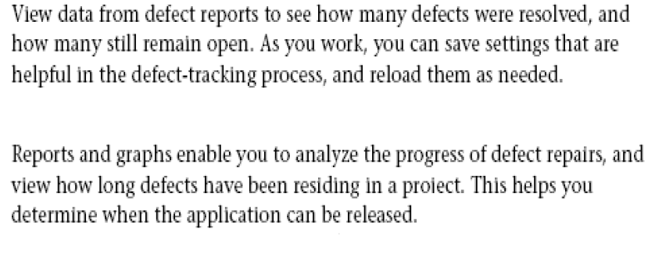
Analyzing Defect Data

Slide 4
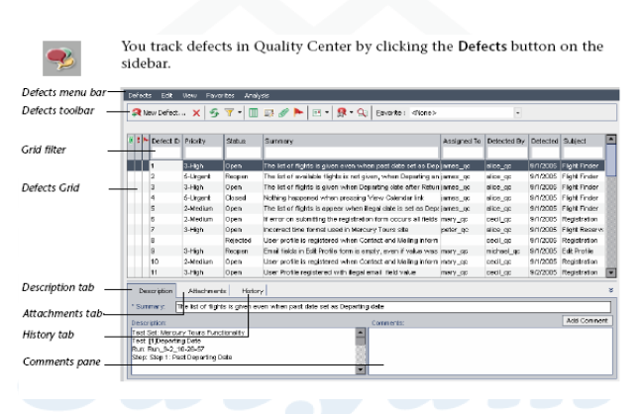
The Defects Module

Slide 5
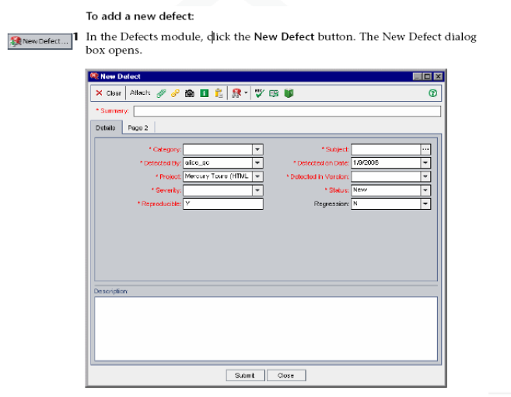
Adding New Defects

Slide 6
Adding New Defects
2. Enter the Defect details.
3. Add attachments.
4. Eliminate duplicates.
5. Spell check.
6. Submit and close

Slide 7
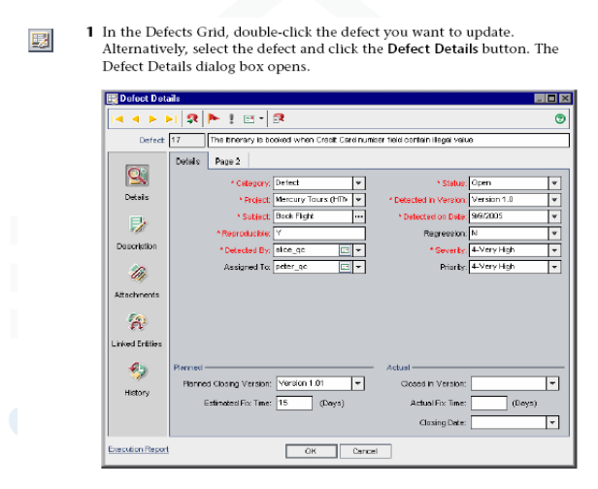
Updating Defects

Slide 8
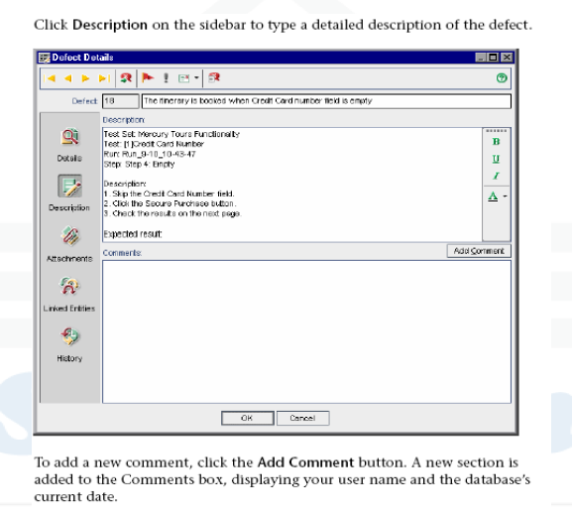
Updating Defects

Slide 9
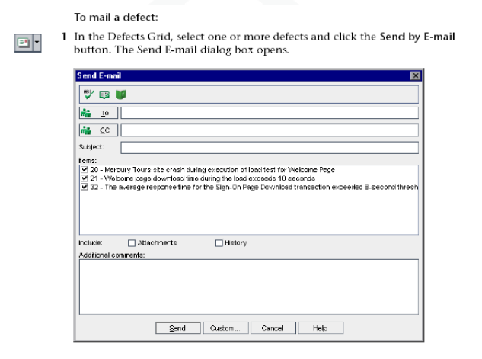
Mailing Defects

Slide 10
Adding New Defects
2. Type a valid e-mail address, or click on to/cc button to display list of users for selection.
3. Enter proper mail subject.
4. In the items box, clear the items you do not want to include in e-mail.
5. Add attachments/history/ additional comments.
6. Spell check.
7. Click Send to send the mail

Slide 11
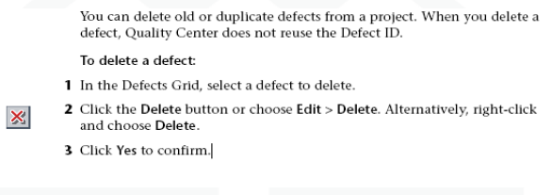
Deleting Defects

Slide 12
Linking Defects to Tests
Display the Test plan module
Select the Test with which you want to link a defect.
For the test select the Linked Defects tab.
Click the Link existing Defects arrow and choose ‘Select’.
In the Defects to link dialog box select the defect and click on Link button.
In the Defects grid for the linked defect verify the ‘Linked Entities property’ in Defect details, a test would appear linked to this Defect.

Slide 13
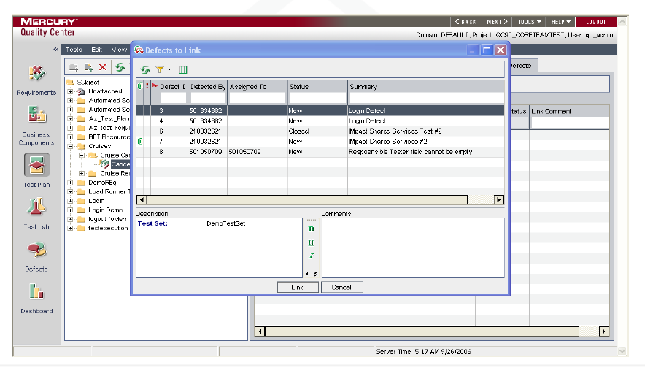
Linking Defects to Tests

Slide 14
Generating Reports
Available Reports.
Requirements module reports.
Test Plan module Reports
Test Lab module Reports
Defects module Reports.

Slide 15
Requirements Module Reports
Standard Requirements
Tabular
Requirements with coverage tests
Requirements with coverage tests and steps
Requirements with linked defects

Slide 16
Test Plan Module Reports
Standard Test Planning
Subject Tree
Tests with Design Steps
Tests with Covered Requirements
Tests with Linked Defects

Slide 17
Test Lab Module Reports
Current Test Set
Cross Test Set
Test Set Hierarchy with Tests
Cross Test Set with Tests
Current Test Set with Failed Test Runs
Cross Test Set with Failed Test Runs
Execution Notification

Slide 18
Defects Module Reports
Standard Defects
Tabular Defects
Defects with Linked Tests and Runs
Fixed or Rejected Defects
Fixed or Rejected Defects detected by Current User.
Opened Defects Assigned to Current User

Slide 19
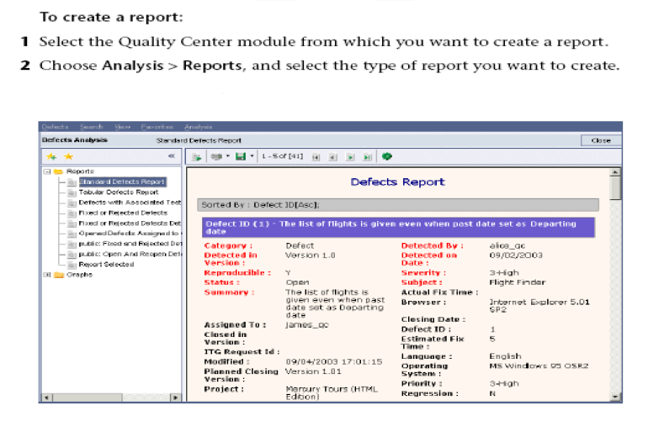
Creating Reports

Slide 20
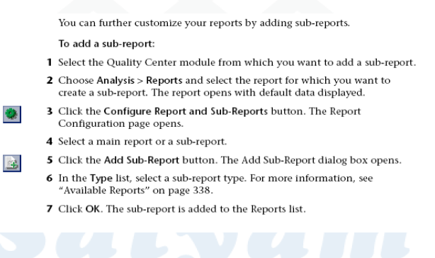
Adding Sub Reports

Slide 21
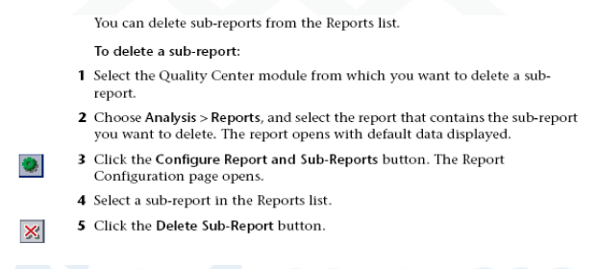
Deleting Sub Reports

Slide 22
Generating Graphs
Quality Center Graph Types
Requirements module Graphs
Test Plan module Graphs
Test Lab module Graphs
Defects module Graphs

Slide 23
Requirements Module Graphs
Requirements –Summary Graph
Requirements –Progress Graph
Requirements –Coverage Graph
Requirements –Trend Graph

Slide 24
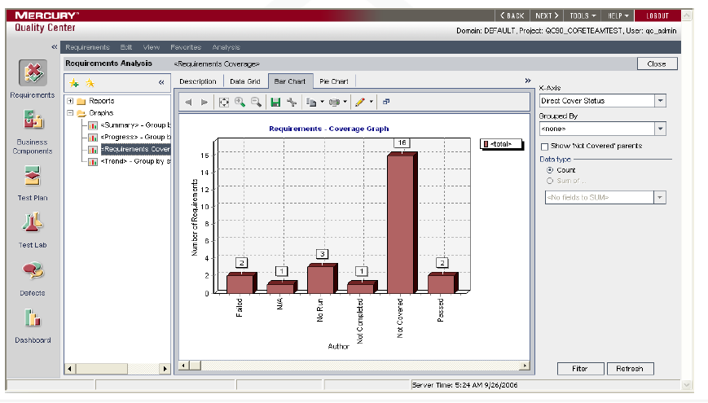
Graphs

Slide 25
Test Plan Module Graphs
Test Planning –Summary Graph
Test Planning –Progress Graph
Test Planning –Trend Graph

Slide 26
Test Lab Module Graphs
Test Execution –Summary Graph (Current Test set)
Test Execution –Progress Graph (Current Test set)
Test Execution –Summary Graph (Cross Test set)
Test Execution –Progress Graph (Cross Test set)

Slide 27
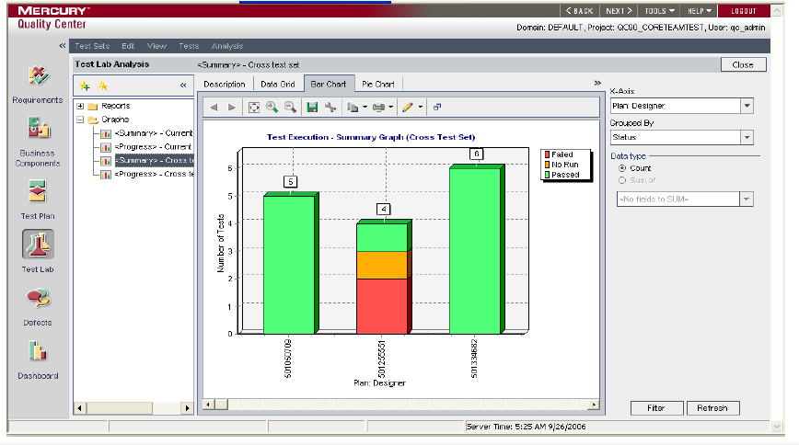
Test Lab Module Graphs

Slide 28
Defect Module Graphs
Defects –Summary Graph
Defects –Progress Graph
Defects –Age Graph
Defects –Trend Graph

Slide 29
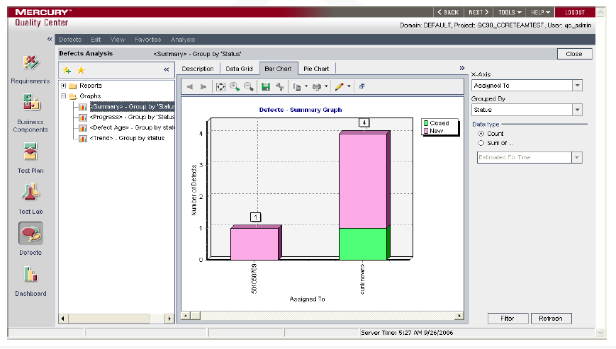
Defect Module Graphs

Slide 30
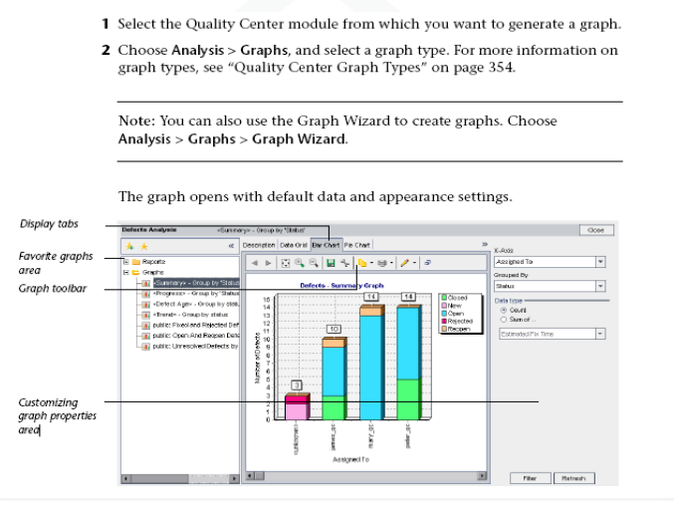
Creating Graphs

Slide 31
Creating Graphs
3. Select an available graph type.
4.Customize Graph Content.
5.Customize Graph settings and appearance.
6.Save the Graph.
7.Close graph wizard.

Slide 32
Recap of activities in QC
Define the requirements and the child requirements in the requirements module.
Create the Test plan i.e. the folder structure and the tests for the project.
Link the tests with requirements.
Create the test steps for Manual tests and script for the Automated tests.
In the Test Lab create the Test set and define the test run properties, test run schedule.
Run the tests in the test lab and add defects where ever applicable.
Track the defects in the defects module till closure.
Analyze the Test run/Defect status on timely basis by generating various reports and graphs.

Slide 33
Thank you

